Slide 1
BT 205: Cell & Molecular Biology
-Prof. Siddhartha Sankar Ghosh

Slide 4
Aminoacylation of tRNA by aminoacyltRNA synthetases:
Step 1 is formation of an aminoacyl adenylate, which remains bound to the active site.
In the second step, the aminoacyl group is transferred to the tRNA. The mechanism of this step is somewhat different for the two classes of aminoacyl-tRNA synthetases.
For class I enzymes, 2a the aminoacyl group is transferred first to the 2′-hydroxyl group of the 3′-terminal A residue, then 3a to the 3′-hydroxyl group by a transesterification reaction.
For class II enzymes, 2b the aminoacyl group is transferred directly to the 3′-hydroxyl group of the terminal adenylate.

Slide 5
Step 1

Slide 6
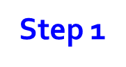

Slide 7
Q Why N-formyl group to the amino group of methionine?
Answer:
Addition of the N-formyl group to the amino group of methionine by the transformylase prevents fMet from entering interior positions in a polypeptide while also allowing fMet-tRNA ^{fMet} to be bound at a specific ribosomal initiation site that accepts neither Met-tRNA^{Met} nor any other aminoacyl-tRNA.

Slide 8
Formation of the initiation complex in bacteria.

Slide 9
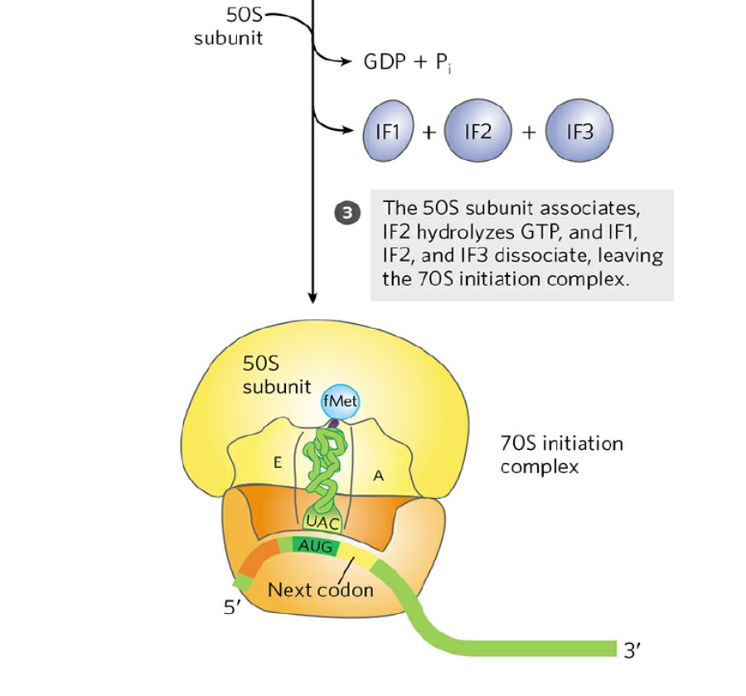

Slide 10
Formation of the initiation complex in bacteria.
The complex forms in three steps (at the expense of the
hydrolysis of GTP to GDP and Pi. IF1, IF2, and IF3 are initiation factors.
E designates the exit site
P, the peptidyl site;
A, the aminoacyl site.
Here the anticodon of the tRNA is oriented 3′ to 5′, left to right.

Slide 12
Messenger RNA sequences that serve as signals for initiation of protein synthesis in bacteria:
Alignment of the initiating AUG (shaded in green) at its correct location on the 30S ribosomal subunit depends in part on upstream Shine-Dalgarno sequences (light red). Portions of the mRNA transcripts of five bacterial genes are shown.
In E. coli, AUG is the start codon in approximately 91% of genes, with GUG (7%) and UUG (2%) assuming this role more rarely.
The Shine-Dalgarno sequence of the mRNA pairs with a sequence near the 3′ end of the 16S rRNA

Slide 13
Stage 3: Peptide Bonds Are Formed in the Elongation Stage

Slide 14


Slide 15
First elongation step in bacteria:
Binding of the second aminoacyl-tRNA. The second aminoacyl-tRNA (AA2) enters the A site of the ribosome bound to GTP-bound EF-Tu (shown here as Tu).
Binding of the second aminoacyl-tRNA to the A site is accompanied by hydrolysis of the GTP to GDP and Pi and release of the EF-Tu–GDP complex from the ribosome.
The bound GDP is released when the EF-Tu–GDP complex binds to EF-Ts, and EF-Ts is subsequently released when another molecule of GTP binds to EF-Tu.
This recycles EF-Tu and makes it available to repeat the cycle. “Accommodation” involves a change in the conformation of the second tRNA that pulls its aminoacyl end into the peptidyl transferase site.

Slide 16
Third elongation step in bacteria: translocation.

Slide 17


Slide 18
Third elongation step in bacteria: translocation:
The ribosome moves one codon toward the 3′ end of the mRNA, using energy provided by hydrolysis of GTP bound to EF-G (translocase).
The dipeptidyltRNA is now entirely in the P site, leaving the A site open for an incoming (third) aminoacyl-tRNA.
The uncharged tRNA later dissociates from the E site, and the elongation cycle begins again.

Slide 19
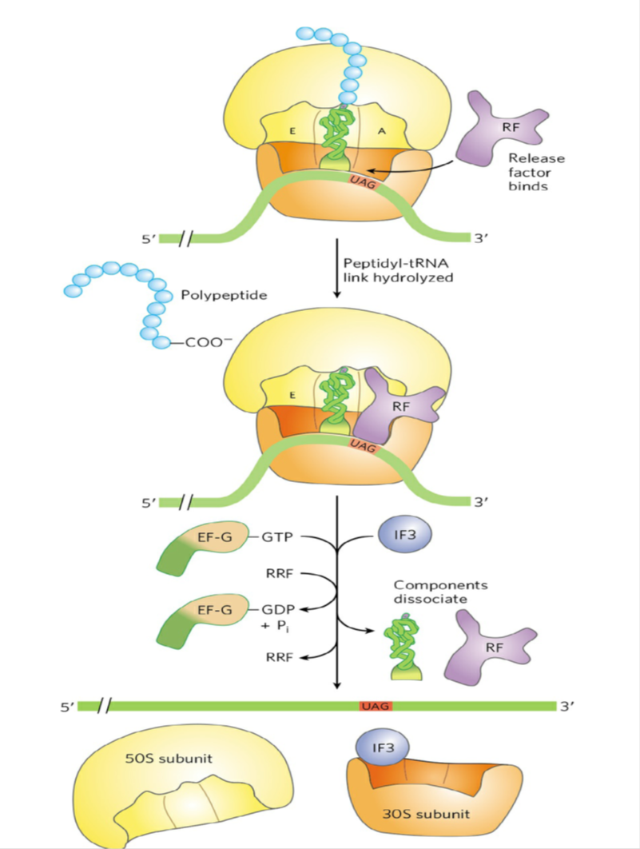
Termination of Polypeptide
Synthesis Requires a Special
Signal

Slide 20
Termination of protein synthesis in bacteria:
Synthesis is terminated in response to a termination codon in the A site. F
irst, a release factor, RF (RF1 or RF2, depending on which termination codon is present), binds to the A site.
This leads to hydrolysis of the ester linkage between the nascent polypeptide and the tRNA in the P site and release of the completed polypeptide.
Finally, the mRNA, deacylated tRNA, and release factor leave the ribosome, which dissociates into its 30S and 50S subunits, aided by ribosome recycling factor (RRF), IF3, and energy provided by EF-G–mediated GTP hydrolysis.
The 30S subunit complex with IF3 is ready to begin another cycle of translation.

Slide 21
QUIZ-2
1. How do you STOP transcription of a gene present in a circular plasmid in absence of both rho dependent or rho independent process?
2. Show schematically transcription activation in eukaryotes with the help of several factors from “off state” to “on state”.
3. Calculate the numbers of introns during splicing of 11 exons having different sizes present in a circular DNA. Show it schematically.
4. What is the strategy to purify mRNA from a mixture of other RNAs in laboratory?
5. Draw the complete Lac operon system. What will be the products in Lac operon in presence of “High glucose, when Lactose is unavailable”?
(Marks: 2+2+2+2+2= 10)

Slide 22
Answer to question 1:
Linearize the circular DNA after the gene .:(Linearization or cutting can be
done by restriction enzymes)
2. It is called “Run Off “ Transcript.

Slide 23
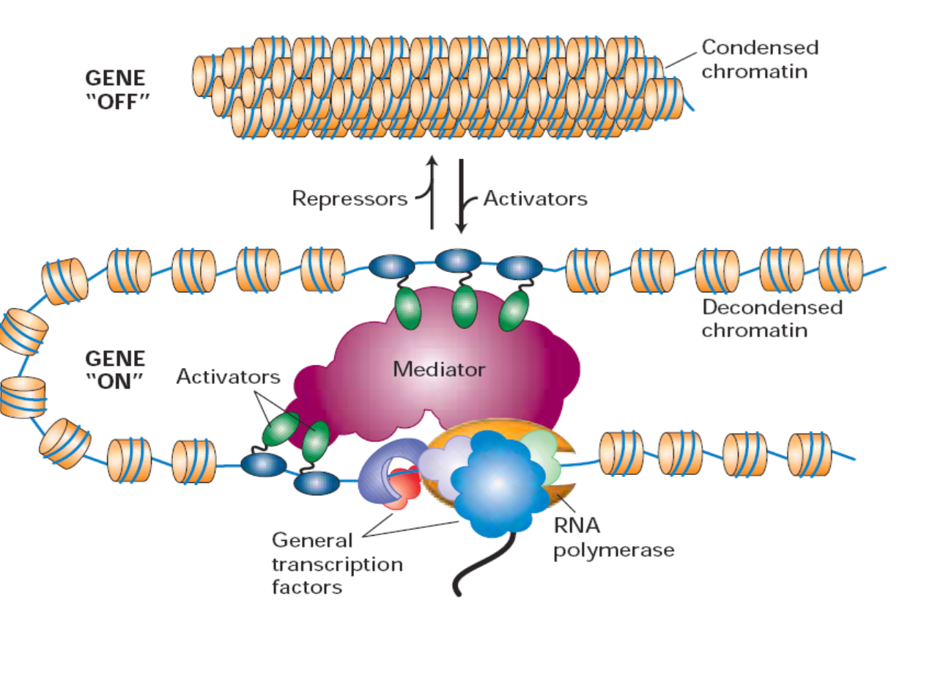
Answer to question 2

Slide 24
Answer to question 3
Exons: 11

Slide 25
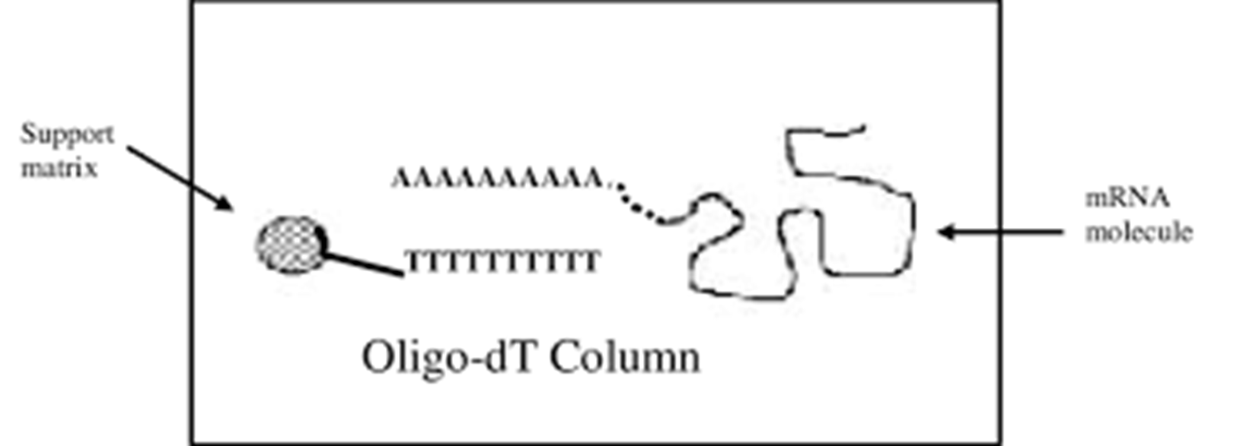
Answer to question 4
Oligo-dT Cellulose Column. Oligo dT isolation is a very useful method for isolating sequences with a poly A tag.

Slide 26
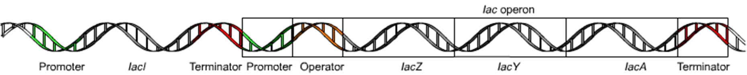
Answer to question 5

Slide 27
THANK YOU

